Slide 1
Pemrograman Berbasis Obyek
Pertemuan 2
PL1AB

Slide 2
Last Meeting Recap
What’s the different between OOP & Procedural Programming in terms of the behaviour & data ?

Slide 3
Last Meeting Recap
In procedural programming, data are referred to as variables, and behaviours are referred to as function
While in OO terminology, data are referred to as attributes, and behaviours are referred to as methods.

Slide 4
1st Example Case : Move a vertex
You were asked to create a program which deals with 2D vertex. This program is able to move the vertex (up, down, left, right)
So please :
Identify the class, attributes, and methods!
Draw the class diagram

Slide 5
visualisasi
4
3
2
1
1
2
3
4
5
6
Notes:
4 buah titik Titik TitikLingkaran TitikPersegi TitikSegi3
Setiap titik punya koordinat - x,y int x x x x
Setiap titik punya warna int y y y y
Setiap titik punya bentuk bentuk r s a
Setiap titik punya ukuran ukuran t
jumlahSudut
Setiap titik bisa: naik, turun, kanan, kiri

Slide 6
Jika bertambah object
4
3
2
1
1
2
3
4
5
6
Notes:
4 buah titik Titik TitikLingkaran TitikPersegi TitikSegi3
Setiap titik punya koordinat - x,y int x x x x
Setiap titik punya warna int y y y y
Setiap titik punya bentuk bentuk r s a
Setiap titik punya ukuran ukuran t
jumlahSudut
Setiap titik bisa: naik, turun, kanan, kiri

Slide 7
2nd Example Case
Anda diminta untuk membuat aplikasi kalkulator waktu. Aplikasi ini dapat melakukan operasi penjumlahan dan pengurangan antara 2 buah waktu yang akan dimasukkan oleh pengguna.
Identifikasikan class, atribut, dan method dari aplikasi tersebut!
Gambarkan class diagramnya!

Slide 8
Try !!
http://ugm.id/pbo22genap
Anda diminta untuk membuat aplikasi kalkulator bilangan pecahan. Aplikasi ini dapat melakukan operasi penjumlahan dan pengurangan, perkalian, dan pembagian antara 2 buah bilangan pecahan yang akan dimasukkan oleh pengguna.
Identifikasikan class, atribut,dan method dari aplikasi tersebut!
Gambarkan class diagramnya!
¾ - ½ = ¼
¾ + ½ = 1 ½
¾ x 2/3 = ½
4/5 : 3/10 = 2 2/3

Slide 9
3rd Example Case : Bookworm
The bookshelves in a university has an id number. Please help to write a program which can add and take a book to the bookshelves. We also would like to know how many books left in the shelves.
Identify the class, attributes, and methods!
Draw the class diagram

Slide 10
4th Example Case : Help Anna (Assignment)
Anna likes collecting branded bags. She usually keeps her bags in her inventory and logs the bag specifications in a piece of paper every time she buys a new bag.
Suddenly, Anna get bored. Not only buying bags, she wants to sell the bag as well. Help her to build an inventory management system to manage her bags and suggest some bags for customers depending on what they’re looking for.
Identify the class, attributes, and methods!
Draw the class diagram

Slide 11
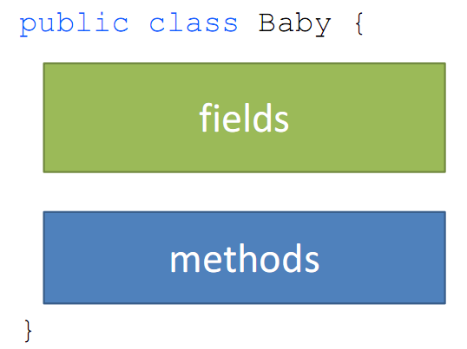
Class Definition

Slide 12
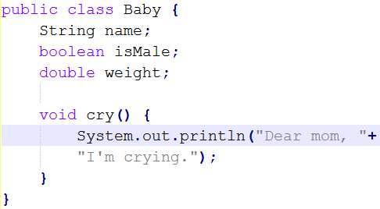
Class Definition

Slide 13
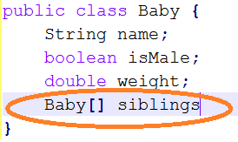
Baby siblings?

Slide 14
Next : How to make baby?
Baby ourBaby = new Baby();
what about it’s name? it’s sex??

Slide 15
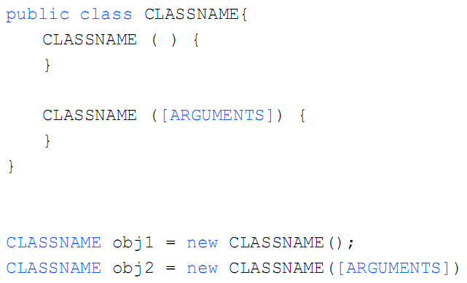
Constructors

Slide 16
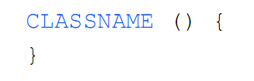
Constructors
Constructor name == the class name
No return type – never returns anything
Usually initialize fields
All classes need at least one constructor
– If you don’t write one, defaults to

Slide 17
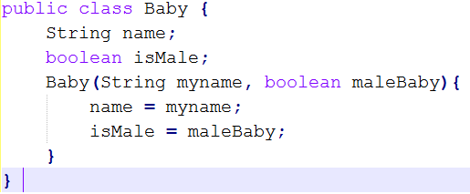
Baby constructor

Slide 18
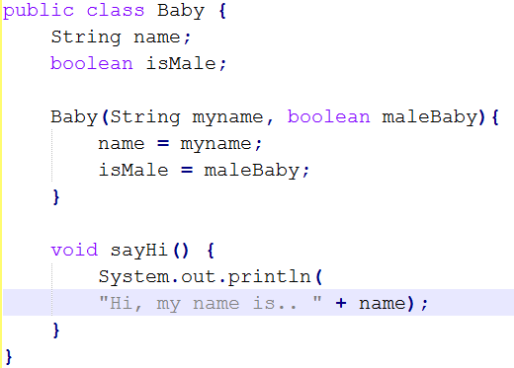
Baby methods

Slide 19
Latihan

Slide 20
Membuat Class Titik
Kelas Titik
attribut x dan y
method
naik()//isinya : y++
kanan()//isinya : x++
turun()//isinya : y--
kiri()//isinya : x--

Slide 21
Create the Class
public class <name> () {
}
Example :
public class Titik () {
}

Slide 22
Define the Attributes
public class <name> () {
<type> <var_name>;
<type> <var_name> = <default_value>;
}
public class Titik () {
double x;
double y;
}

Slide 23
Determine the Methods
public class <name> () {
//attributes
void <method_name>();
void <method_name>(<type> <name_params>);
}
Example :
public class Titik () {
double x;
double y;
void naik(){ y++;}
void turun(){ y--;}
void kanan(){ x++;}
void kiri(){ x--;}
}

Slide 24
Constructor
public class <class_name> () {
public <class_name>() {
}
public <class_name> ( <type> <param1> , etc) {
}
}
public class Titik () {
public Titik () {
x = 0;
y = 0;
}
public Titik (double x, double y) {
this.x = x;
this.y = y;
}
}
Example :

Slide 25
Full Class Implementation

Slide 26
Create the object
<class name> <obj name> = new <class name>();
<class name> <obj name> = new <class name>(<type> <name_param>, etc);
Example :
Titik pojokKiri = new Titik ();
Titik pojokKanan = new Titik(1, 4)

Slide 27
Assign the attribute & call the method
Titik t1 = new Titik();
t1.x = 5;
t1.y = 8;
t1.naik();
t1.turun();
t1.kanan();
t1.kiri();

Slide 28
Membuat Class Titik dan Garis
Kelas Titik
attribut x dan y
method
naik()//isinya : y++
kanan()//isinya : x++
turun()//isinya : y--
kiri()//isinya : x--
Kelas Garis
attribut titikAwal dan titikAkhir
method
getPanjang() //isinya :
jarakX = Math.pow((titikAkhir.x-titikAwal.x),2);
jarakY = Math.pow((titikAkhir.y-titikAwal.y),2);
jarak = Math.pow((jarakX+jarakY),0.5);
return jarak;

Slide 29
Thank you ☺ Any Question ?

